Slide 1

Opening a New Shopping Mall in rome, Italy
Coursera Capstone IBM Applied Data Science Capstone
By: Nour Shosharah

Slide 2
Introduction :
Business problem :
The importance of a shopping mall is mainly for people to get out of the house for a while and do something entertaining. Shopping malls can provide the best shopping experiences such as social gatherings, entertainment, performances, product launches, promotions and festivals. The events list at shopping malls goes on and on for any, particular, person to be entertained for a number of hours
Location of the shopping problem mall is one of the most important decisions that will determine whether the mall will be a success or failure
Business question : in the city of Rome , Italy if a property developer is looking to open a new shopping mall, where would you recommend that they open it?
Objective : to analyze and select the best location in the city Rome , Italy to open a new shopping mall

Slide 3
Data :
Data needed and sourced :
Data required :
• List of neighborhoods in Rome , Italy
• Latitude and longitude coordinates of those neighborhoods
• Venue data, particularly data related to shopping malls.
Data sourced:
This Wikipedia page (https://en.wikipedia.org/wiki/Category:Subdivisions_of_Rome) contains a list of neighborhoods
Python Geocoder package for latitude and longitude coordinates of the neighborhoods.
Foursquare API (https://foursquare.com/) to get the venue data for those neighborhoods

Slide 4
Methodology
web scraping using Python requests and beautiful soup packages to extract the list of neighborhoods
get the geographical coordinates in the form of latitude and longitude using Python Geocoder package
Using Foursquare API (https://foursquare.com/) to get the venue data
Analyze each neighborhood by grouping the rows by neighborhood and taking the mean of the frequency of occurrence of each venue category.
Filter venue category by Shopping Mall
perform clustering on the data by using k-means clustering

Slide 5
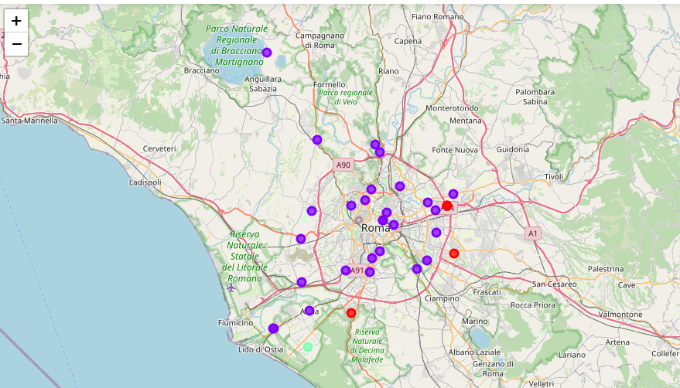
Results
categorize the neighborhoods into 3 clusters based on the frequency of occurrence for “Shopping Mall”:
Cluster 0:
Neighborhoods with moderate number of shopping malls
Cluster 1:
Neighborhoods with low number to no existence of shopping malls
Cluster 2:
Neighborhoods with high concentration of shopping malls

Slide 6
Discussion
The highest number of shopping mall in cluster 2 and moderate number in cluster 0 . On the other hand, cluster 1 has very low number to no shopping mall in the neighborhoods.
Recommendations
The neighborhoods in cluster 1 are the most preferred locations to open a new shopping mall.

Slide 7
Conclusion :
To answer the business question :
The neighbourhoods in cluster 1 are the most preferred locations to open a new shopping mall. The findings of this project will help the relevant stakeholders to capitalize on the opportunities on high potential locations while avoiding overcrowded areas in their decisions to open a new shopping mall.

Slide 8
Recourses :
References
Category: Subdivisions of Rome in Wikipedia. Retrieved from https://en.wikipedia.org/wiki/Category:Subdivisions_of_Rome
Foursquare Developers Documentation. Foursquare. Retrieved from https://developer.foursquare.com/docs

